Slide 1
Installation of ETL Software and Exam 1

Slide 2
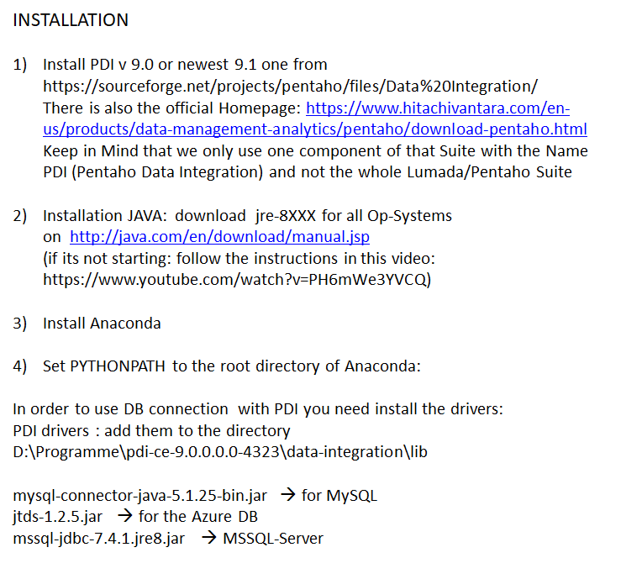

Slide 3
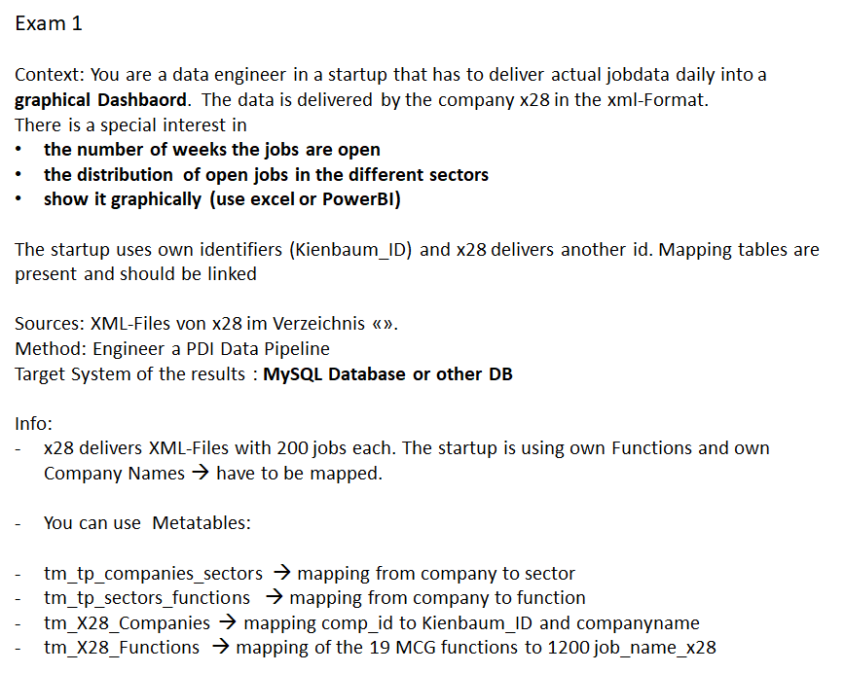

Slide 4
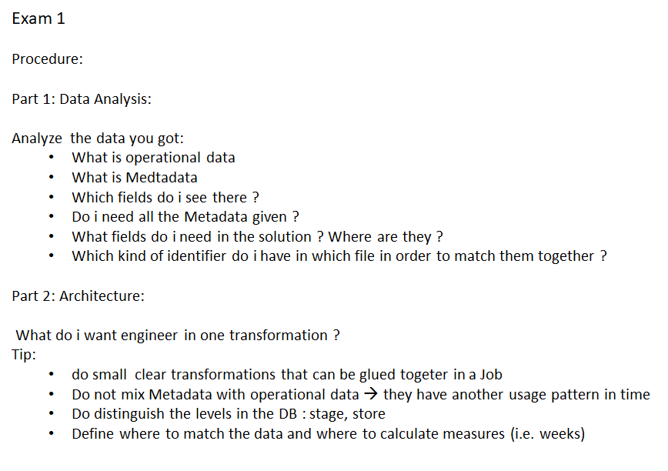

Slide 5
